Slide 1

Mortality and Socio-Economic Factors
Team DOMARA

Slide 2
The Question
How do socio-economic and behavioral factors relate to mortality globally?

Slide 3
Data Sources
World Health Organization – Global Health Observatory
(api available)
CIA World Factbook
(api available)
World Bank – IndexMundi
(api available)
United Nations Development Programme
(xlxs files available)
Natural Earth (Graphing)

Slide 4
Why we limited our study to Countries with at least 1MM population
The 159 countries considered represent over 99% of the world’s population and two-thirds of the world’s nations.
Small countries had high variances in results and could distort results out of proportion to their influence.

Slide 5
Initial Operations
A prescribed panda format was established for the data to be used, so modular work could be done.
A small sample csv file data for 24 countries was manually prepared and used to test the program before using the full data.

Slide 6
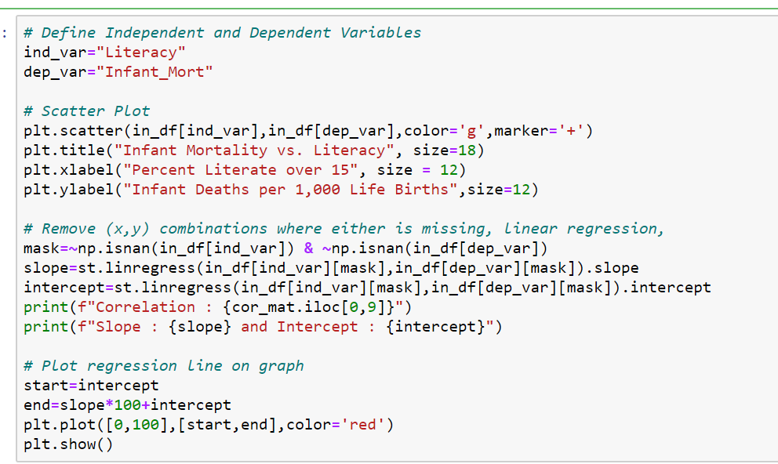
Script for a Graph and Analytical Data

Slide 7
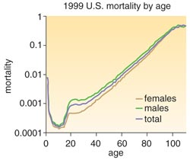
A Mortality Curve
“I think people would live a bit longer if they didn’t know how old they were. Age puts restrictions on things.”
-- Karl Pilkington

Slide 8
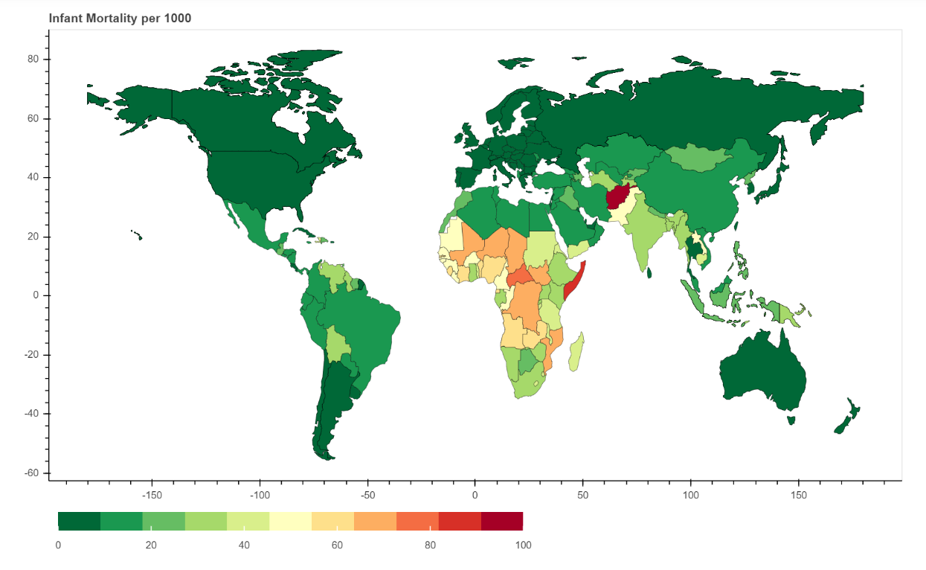
Infant Mortality – Health Access

Slide 9
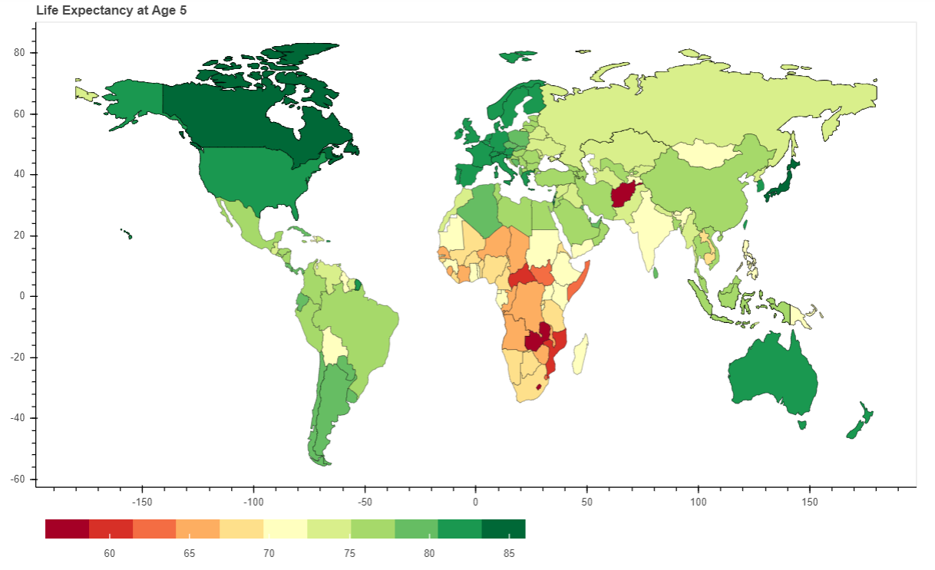
Life Expectancy at 5 - Behaviors

Slide 10
Variables Considered
Form of Government (Removed due to complexity)
Education
Income
Medical Resources
Human Behaviors

Slide 11
Analyses
Matrix of Correlation Coefficients
Visually Reviewed Graphs, Charts and Histograms
Regressions
Investigated unexpected results

Slide 12
Correlation Matrix

Slide 13
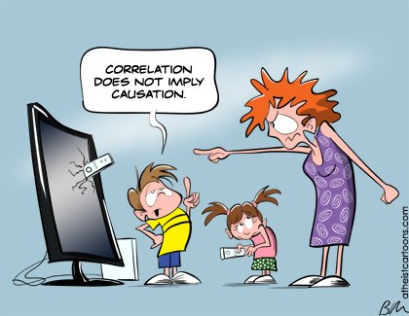
Findings

Slide 14
Education
Highest Linear Correlations
Literacy – Infant Mortality
Education Level – Adult Life Expectancy

Slide 15
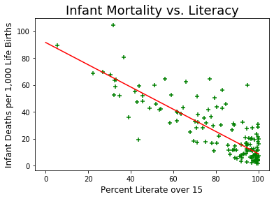
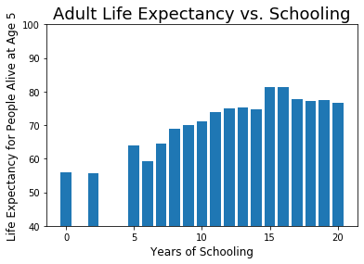

Slide 16
Medical Resources
Medical spending as a percent – 9-13% correlation – insignificant
The actual funds spent per capita had a high impact on mortality (Correl to log about 80%)
The number of physicians per 1,000 population had a significant impact on mortality. (Correl near 70%)
Beds had a modest impact on the mortality rates. (Correl in the 20%-40% range)

Slide 17
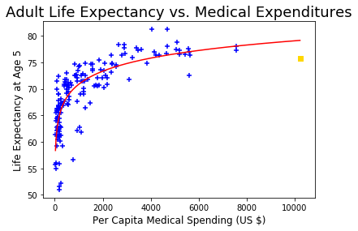
Life Expectancy vs. Amount Spent on Medical
The actual dollar equivalent amount was found to be more of an indicator than the percentage of income spent on medical services. The logarithmic fit shows diminishing gains.

Slide 18
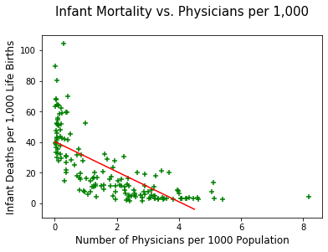
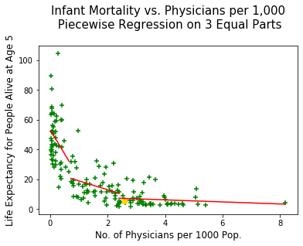
Infant Mortality vs. Physicians per 1,000 (Piecewise indicates impacts of 32, 6 & ½)

Slide 19
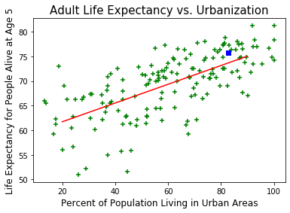
Urban Living (is not Dying)
With a correlation 0.60,

Slide 20
Income
Modest Linear Impact
(60%Correl.)
Logarithm of PCI
(80% Correl.)
Intercorrelated
with Education

Slide 21
CAVEAT
“Jumping to conclusions usually hurts someone …
… either the one jumping or the one jumped on or both.”
--- Captain Jack Sparrow

Slide 22
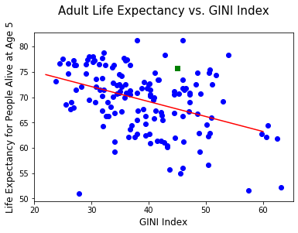
Income Equality
Moderate correlation (about 40%)
Countries with a substantial middle class have longer life expectancy.

Slide 23
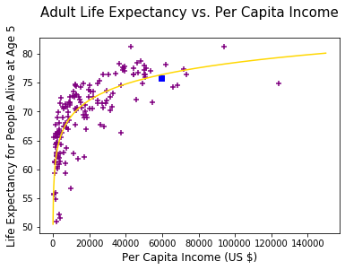
Income and Adult Life Expectancy
Fit to a logarithmic curve.
The impact of the initial earnings are much higher than additional earnings.
This indicates there is a diminishing return to the health value of increased income.

Slide 24
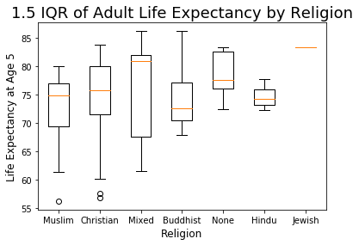
Religion
A country’s predominant religion did not have a statistically significant impact on life expectancy.

Slide 25
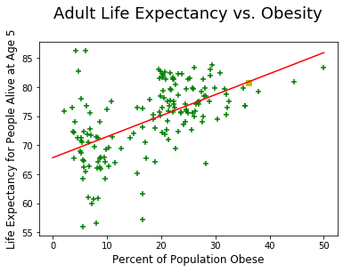
Obesity
Obesity study results indicated that as the percentage obesity in a nation increases, so does life expectancy.
This was the opposite of what we were expecting.

Slide 26
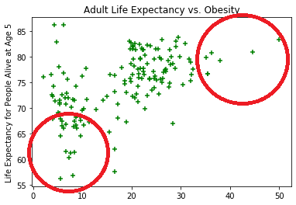
Now What?
We investigated the extremes to understand what the data was telling us.
Countries in the lowest (and highest) quartiles in both obesity and in life expectancy at age 5.

Slide 27
Obesity
Factor | Bottom Quartile in Both Obesity and Life Expectancy | Top Quartile in Both Obesity and Life Expectancy
Count | 21 | 17
Education (School Life Exp.) | 8.7 years | 16.4 years
Per Capita GPD | $4,200 | $50,412
Doctors/1,000 | 0.15 | 2.44
HIV Infection Rate | 3.04% | 0.16%
Description | Generally Africa and SE Asia | Highly Developed Countries

Slide 28
Conclusions
Per capital income has a significant impact on a nation’s mortality, but the impact diminishes as income rises.
Education (levels and literarcy) appear to be significant drivers of the country’s mortality after a minimal level of per capita income is attained.
National correlations should not be applied to individual behaviors due to intercorrelations.

